Slide 1
Supplier Management APPlication
MINIMUM VIABLE PRODUCT (CRUD)
Tech Stack : Node.js, Express, Express-Handlebars and MySQL.

Slide 2
Scenario
I am invited to attend a meeting with the board of directors of a small company that sells cleaning products. I am an independent vendor selected by them to supply them with your skills in developing applications for them. At the meeting they show me a short presentation of what they need the application to do.
They have requested that I provide them with a Prototype / POC / MVP of the application within 1 to 2 days in order to prove to them that I am the right contractor for the job. If I am successful in delivery the MVP I will be awarded the contract.

Slide 3
Problem
They have a list of suppliers and want the Supplier database to be available to all their Sales staff that is constantly on the road trying to get new business.
The application will grow into a bigger application whereby
they will be doing Ordering/Warehouse Management/Logistics and Finances on the application.

Slide 4
Requirements
Have an input screen whereby sales can input a company name and telephone no.
A screen where they can search by company name and it will display the supplier’s telephone number.
It must save the information to an actual database.
It must have a middle layer due to additional security (3-Tier application – Front Layer, Services Layer and Repository)

Slide 5
01
PROBLEM VS. SOLUTION
HOW DID I GO ABOUT THIS ?

Slide 6
01
CRUD APP
02
Tech Stack
SOLUTION
03
TOOLS & LIBRARIES
04
BUSINESS MODEL
Create, read, update & delete
Nodejs, JavaScript, Express, MySQL & Handlebars, Apache
Visual Studio Code, XAMPP local server, phpMyAdmin
Simple

Slide 7
Backend Development
Create an MS-SQL database.
Set up a table for storing supplier information
Establish a connection string to your database in your local server.
Display results from the server on the frontend.
Implement functions to insert new supplier data into the MS-SQL database and retrieve supplier information based on company name.
Perform unit testing and verify that data is being saved and retrieved correctly from the database.

Slide 8
Frontend Development
Create Handle bar components for the input screen and the search screen.
Implement a form on the input screen where sales can input a company name and telephone number.
Implement a form on the search screen where sales can search for a supplier by company name.
Manage user inputs and display results.

Slide 9
Documentation & Presentation
Upload the Prototype to a GitHub repository.
Document the setup, architecture, and how to run the application.
Provide clear instructions for running both the frontend and backend components.
Prepare a presentation for the board of directors to demonstrate the POC.
Show how the application meets the requirements and functions.

Slide 10
FEATURES
CRUD (GET, POST, UPDATE, DELETE)
Get new suppliers
Add the new supplier to the database
Update the supplier information
Delete the supplier
*Additional feature - Activate and deactivate supplier from the web application. (The supplier still stays in the database but will not been shown in the actual web application if the database status is anything else besides “active”)

Slide 11
Minimum viable product
This is a proof of concept (POC) and can serve as the foundation for a larger application that includes more features like ordering, warehouse management, logistics, and finances.

Slide 12
Vision & Goals!
I aimed to create an application that not only demonstrated my technical abilities but also showcased my creativity and problem-solving skills. By combining my educational background and coding experience, I was able to achieve my vision and create a user-friendly application that stands out in the competitive software development field.

Slide 13
Conceptualization & Architecture!
I focused on creating a simple intuitive and user-friendly interface. I considered the optimal organization of components and functionality, ensuring a seamless user experience. Additionally, I considered the scalability and maintainability of the application's architecture, allowing for future growth and enhancements.

Slide 14
Development Process
During the development process of my application, I followed an agile approach, breaking down the project into manageable tasks and iterations. I utilized industry-standard programming languages and frameworks, ensuring optimal performance and security. Regular testing and debugging were conducted to ensure a robust and error-free application.

Slide 15
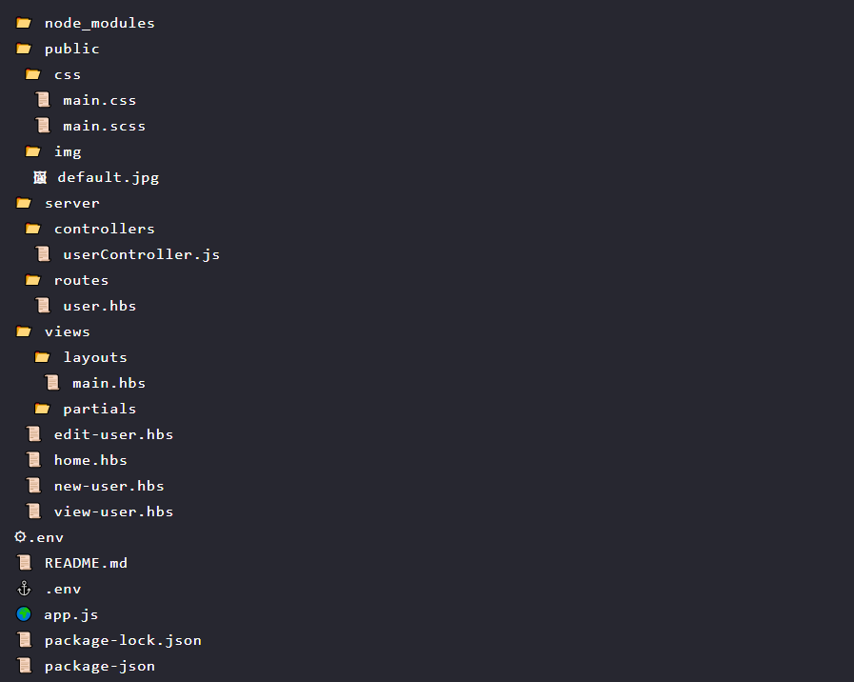
File Structure

Slide 16
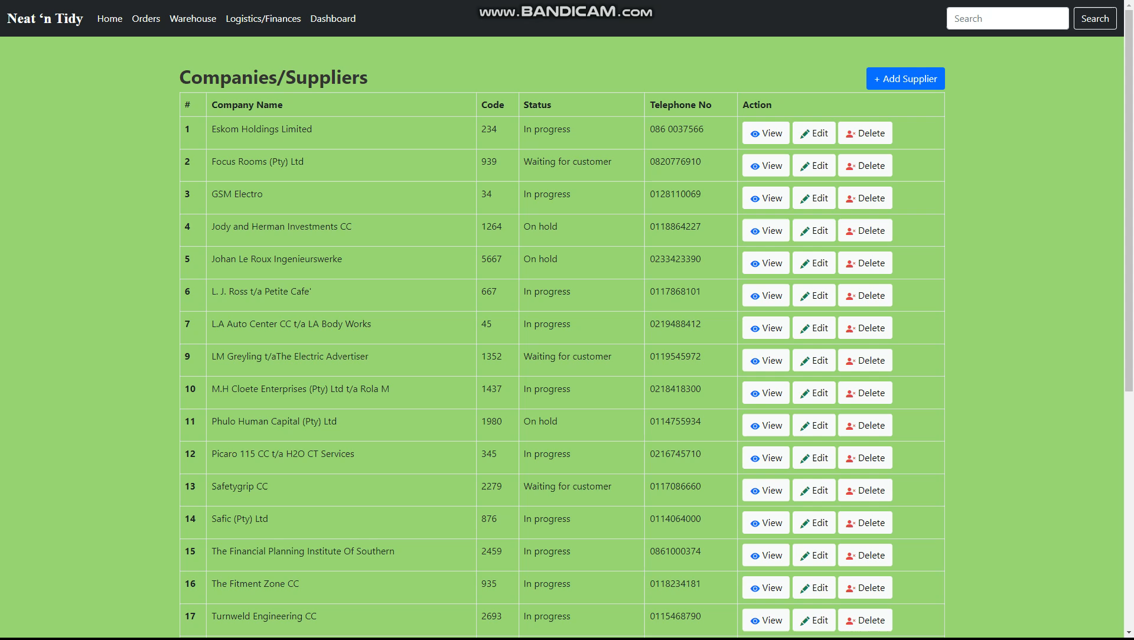
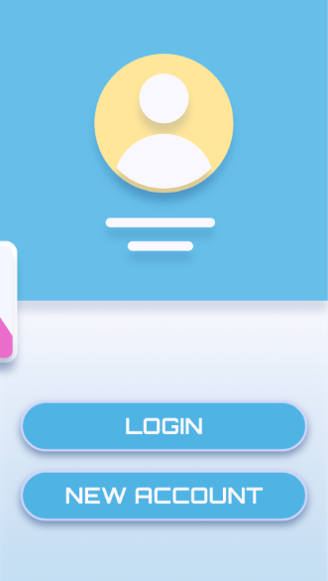
PRODUCT DEMO
https://github.com/Raphael-devlpr/Supplier-management-System

Slide 17
PRODUCT DEMO
The final MVP is available on my GitHub repository. Instructions on how to run the application are detailed in the Readme.md file.
For your convinience & upon request I can provide my personal directory of the Xampp folder, which includes the SQL DATA which you can copy replace in your Xampp directory once you’ve installed Xampp.
https://github.com/Raphael-devlpr/Supplier-management-System

Slide 18

THE DEVELOPER/ Code whisperer
RAPHAEL MUNAKI
“Good sense, disciplined by experience and inspired by goodness”

